Slide 1

TOWN OF CHEEKTOWAGA
2027 Preliminary Budget Hearing
October 27, 2026

Slide 2
Average homeowner’s tax bill

Slide 3
The Budget Process
  Early August - requests are sent to each department head
  Late August - departmental requests due to Supervisor and are then reviewed and evaluated
  Late August/early September – departmental budgets accumulated and requests are reviewed by the Supervisor and Director of Finance
  Mid September - payrolls, benefits, debt service, estimated revenues are all computed
  Mid September – complete budgets for each fund, determine tax rate implications and make adjustments
  September 30 - File tentative budget
  October - hold public hearing, consider comments and make adjustments
  November - Adopt budget and submit to County (by 11/20)

Slide 4
TOWN OF CHEEKTOWAGA
Two budgets for consideration:
Benefit Basis Budget
  Termed such because taxes are levied on the basis of the level of services received in specific areas of Town
  Includes sewer, hydrant districts, and drainage
Ad Valorem Budget
  Termed such because taxes are levied based on assessed real property value
  Includes general, town-outside village, highway, garbage and lighting funds

Slide 5
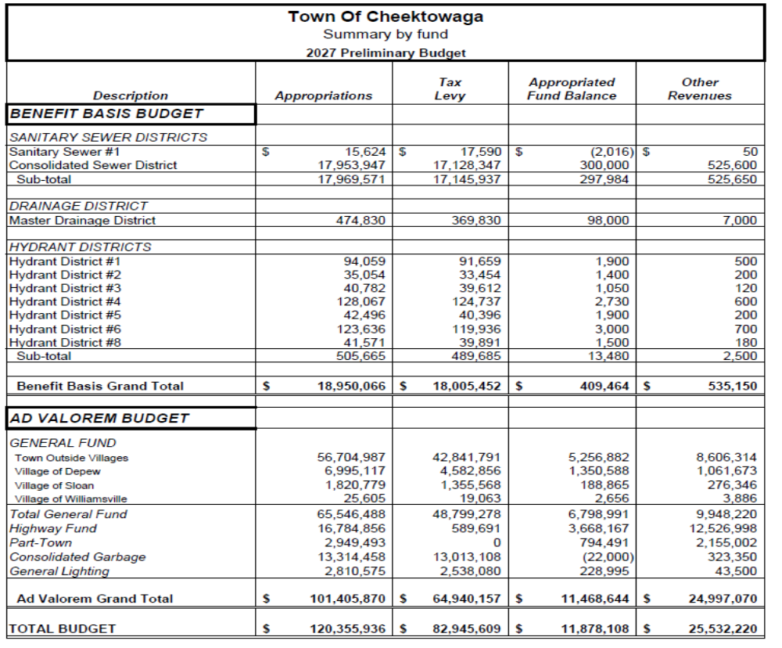

Slide 6
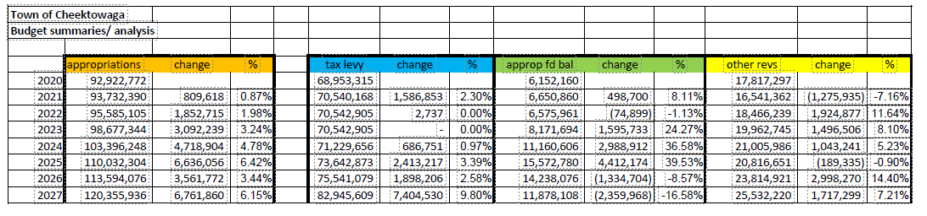

Slide 7
How The Budget Works

Slide 8
Tax cap
The NYS Property Tax Cap is limited to an increase in property taxes to the lower of:
  Two percent; or
  the rate of inflation which for 2027 has been determined to be 2.0%
The State has a website that assists in the calculation of our Town’s specific cap that also allows for adjustments related to PILOTs and excludible costs such as pension costs.
The Town’s allowable increase in tax levy per the NYS calculations is $1,499,970 or 2.0% increase

Slide 9
Appropriations by function
Public Safety (Police & code enforcement) Sewers, Storm Drainage & Hydrants General Govt –courts, assessor, town clerk & admin offices | 35.7% 16.0% 14.7%
Highway & Street Lighting | 13.7%
Garbage & recycling | 11.8%
Culture & Recreation – parks, youth, recreation & seniors | 8.1%

Slide 10
Appropriation changes
New union contracts wage increases +1,180,170
Increase for union wage step increases +105,694
Increase in OT budgets mainly due to contract increases +$126,882
Added positions:
  Asst. Dir of Info Technology
  Deputy Highway Superintendent
  Sr. Engineering position in highway
  2nd full-time dog control officer
Eliminated positions:
  Town Comptroller
  Auto mechanic
  Highway laborer
Decrease contractual sellbacks -168,500
Part-time & seasonal payroll
  Add PT pool staffing + 113,700
Total payroll adjustments – increase of $1,684,532

Slide 11
Appropriation changes
EQUIPMENT:
Sanitation packer truck +340,000
Sanitation tote replacements +20,000

Slide 12
Appropriation changes
Non Personnel (Outside contracts or services) appropriations
  Contractual cost savings due to streetlight LED conversion project -120,000
  Gas and diesel costs + 120,000
  Building utility costs +215,000
  Highway road salt +392,000
  Highway blacktop +375,000
Items adjusted due to contractual agreements:
  Buffalo Sewer Authority contractual charge increase +250,000
  Erie County sewer charges and other sewer repairs +83,000
  Sanitation landfill costs increase $140,500
  Recycling program contract increase $324,200
Total Contractual lines increases were $2,027,629

Slide 13
Appropriation changes
Fringe Benefit cost changes due to the following:
  Payroll taxes increased due to wage increases by $89,000
  Retirement costs driven mainly by the NYS retirement rate increased budget by $550,000
  Employee and medical costs increases $1,515,000
Debt service increased due to new bonding in 2026 to fund capital infrastructure costs and heavy equipment replacement + $640,000

Slide 14
Other Revenues
Our “budgeted other revenue streams” has increased
  Interest income +$205,000
  Police revenue increases relating to grants and other agreements with other organizations for use of employees (OT reimb) or use of our training facilities + $60,000
  Tax on adult use cannabis +100,000
  Sales tax estimates +304,000
  Hotel bed tax estimated increase of $1,000,000
  Mortgage tax estimate increased by 100,000
  Overall, our budgeted Other Revenue number increased by a total of $1,721,299

Slide 15
Appropriated fund balance
This is a planned use of our cash reserves.
We plan to decrease our use of reserves by $2,359,968
This is a result of our fund balance policy which states that we plan to maintain fund balances of not less than 15% of our annual appropriations.

Slide 16
Budget change summary
 |  |  | Other | Appropriated | Tax
 | Appropriations |  | Revenues | Fund Balance | Levy | Total
2026 Budget | $ 113,594,076 |  | $ 23,814,921 | $ 14,238,076 | $ 75,541,079 | $ 113,594,076
Adjustments for 2027
Increase of other revenues |  |  | 1,721,298 |  |  | 1,721,298
Reduce use of fund balance/reserves |  |  |  | (2,359,968) |  | (2,359,968)
Payroll increases | 1,684,532
Equipment increases | 350,556
outside contracted costs increases | 2,027,629
Fringe benefits | 2,059,573
Debt service change | 639,570
Amount of property taxes to balance budget | - |  | - | - | 7,400,530 | 7,400,530
Total adjustments | 6,761,860 |  | 1,721,298 | (2,359,968) | 7,400,530 | 6,761,860
% change | 5.95% |  | 7.23% | -16.58% | 9.80% | 5.95%
2027 Budget | $ 120,355,936 |  | $ 25,536,219 | $ 11,878,108 | $ 82,941,609 | $ 120,355,936

Slide 17
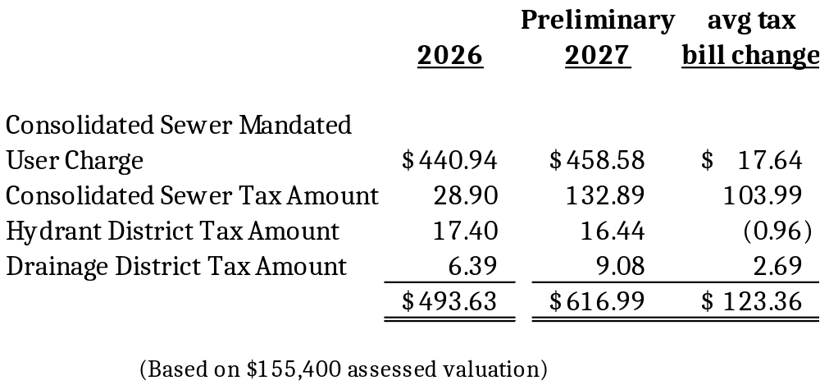
2027 Benefit Basis Budget

Slide 18
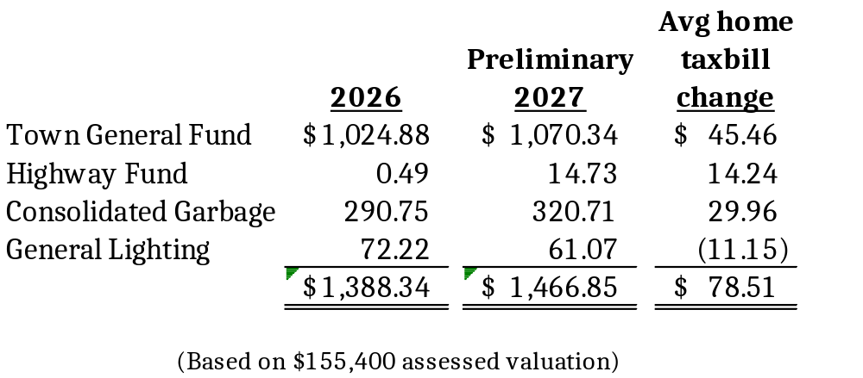
2027 Townwide
(ad-valorem) taxes

